Slide 1

CSE460: VLSI Design
Lecture 15

Slide 2
CMOS DC Characteristics

Slide 3
Contents
CMOS Inverter DC Characteristics
Noise Margin
nMOS & pMOS Pass Transistor DC Characteristics

Slide 4
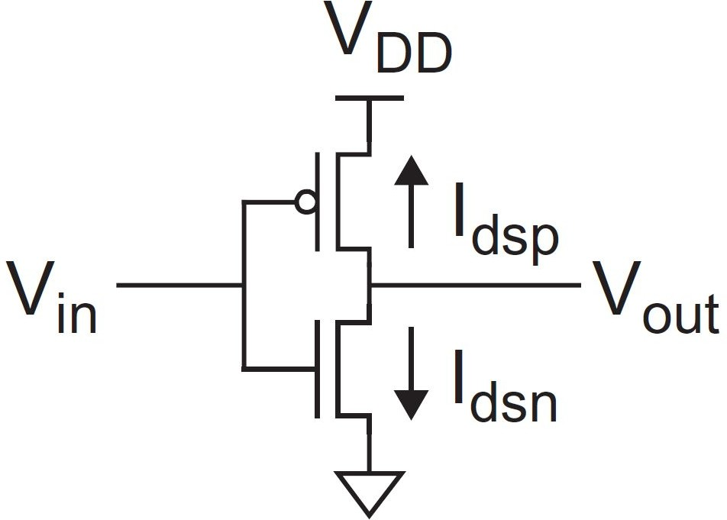
Static CMOS Inverter
A static CMOS inverter is built using a pMOS and an nMOS
DC Transfer function or DC response: V_{out} vs V_{in}
For the CMOS inverter shown:
V_{in} = 0 ⇒
●
In between these 2 cases, V_{out} depends transistor current
V_{out} vs V_{in} relationship can be found by setting I_{dsn} = |I_{dsp}|
V_{out} vs V_{in} relationship can also be found via graphical solutions
^{V}out ^{= V}DD
^{V}in ^{= V}DD
⇒ V_{out} = 0

Slide 5
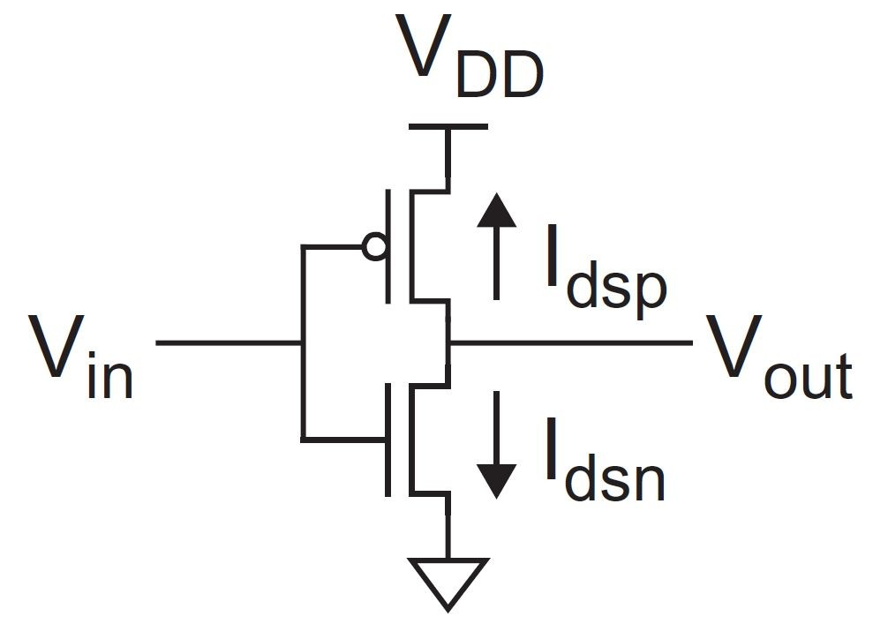
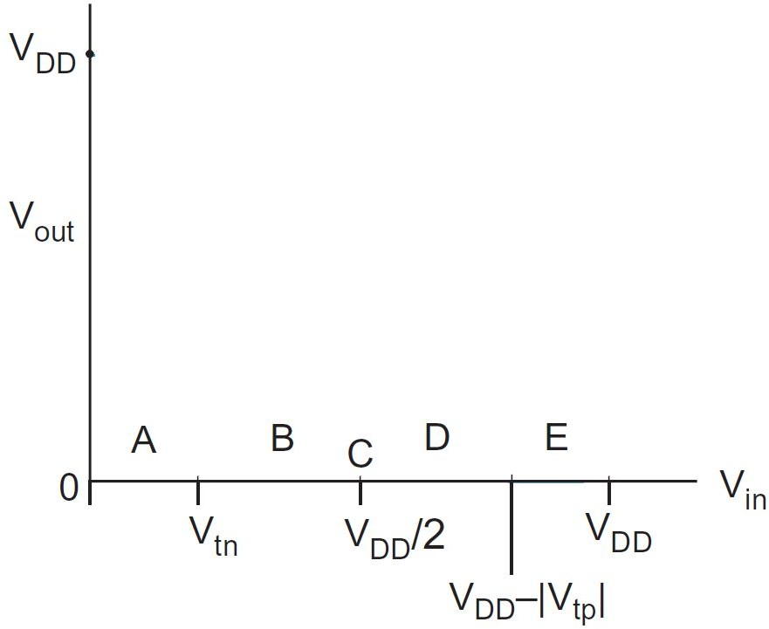
CMOS Inverter DC Response
CMOS Inverter DC response can be determined as:
1. Divide the input into 5 different regions:
A: 0 ≤ V_{in} < V_{tn}
B: V_{tn} ≤ V_{in} < V_{DD}/2
C: V_{in} = V_{DD}/2
D: V_{DD}/2 < V_{in} ≤ V_{DD} - |V_{tp}|
e.
E: V_{in} > V_{DD} - |V_{tp}|
Determine the operating regions of the devices
Cutoff, Linear or Saturation?
Approximate V_{out} at A, B, C, D & E regions depending on the pMOS and nMOS operating regions

Slide 6
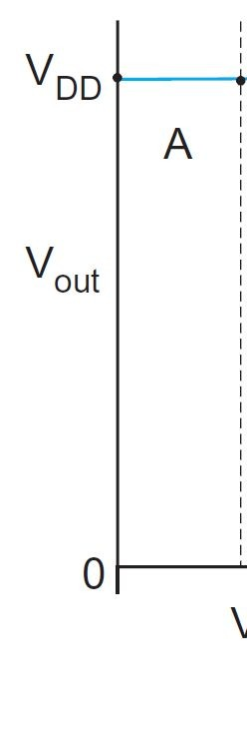
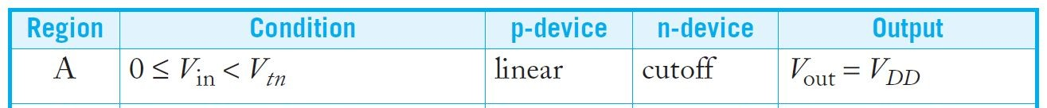
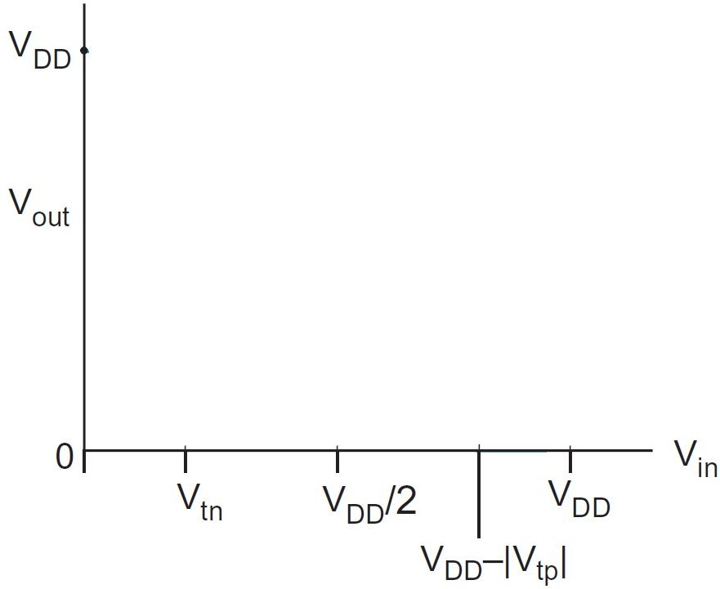
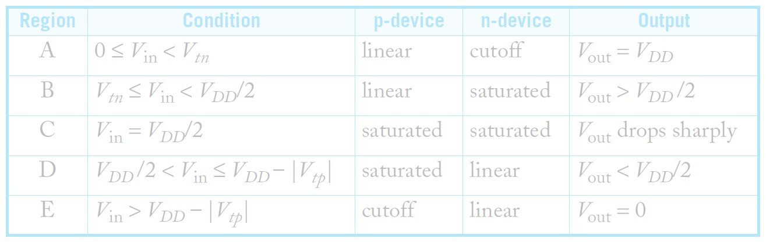
CMOS Inverter DC response
Region A

Slide 7
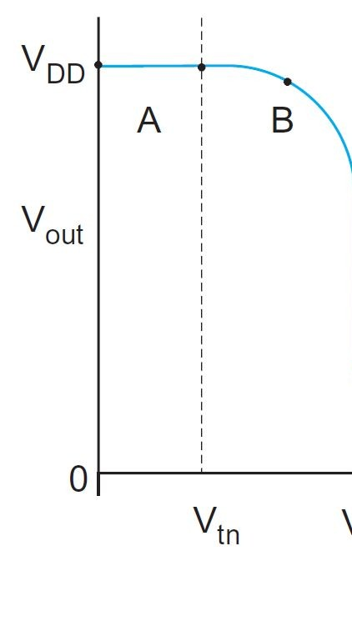
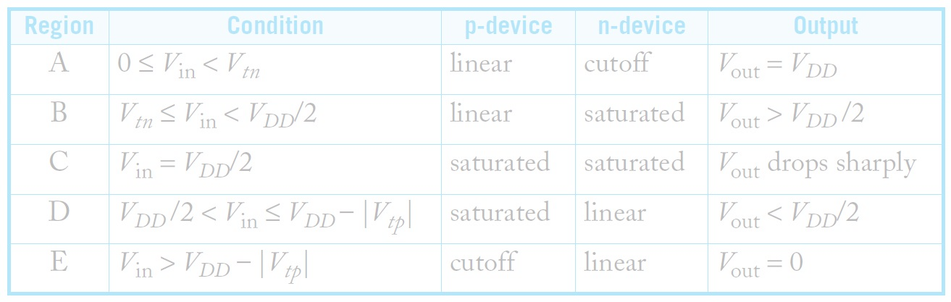
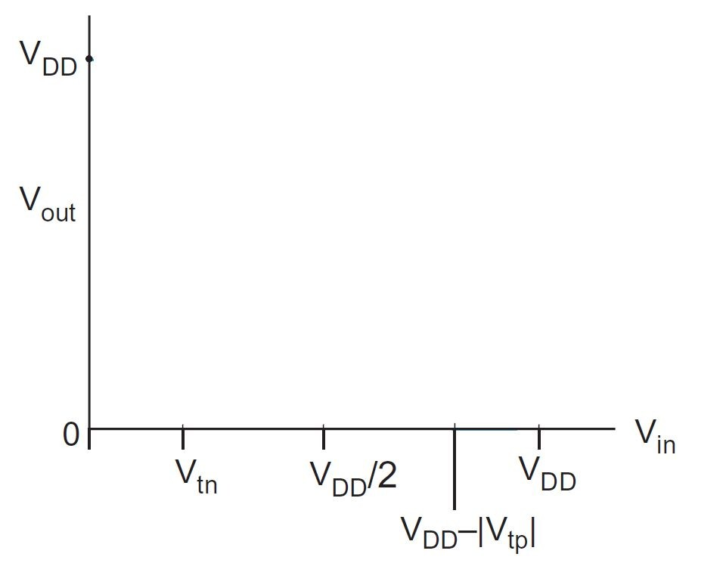
CMOS Inverter DC response
Region B

Slide 8
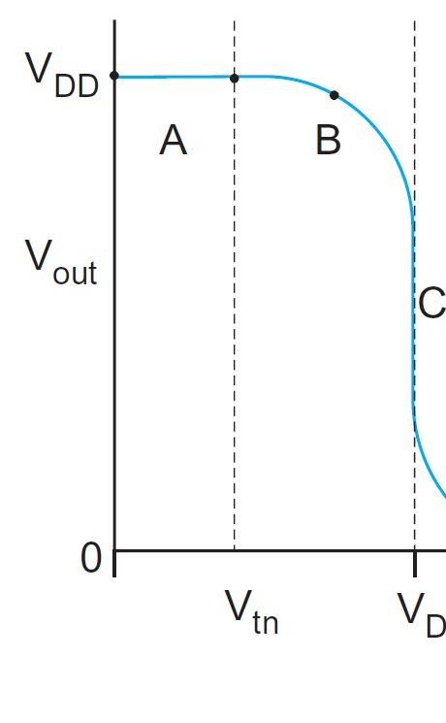
CMOS Inverter DC response
Region C

Slide 9
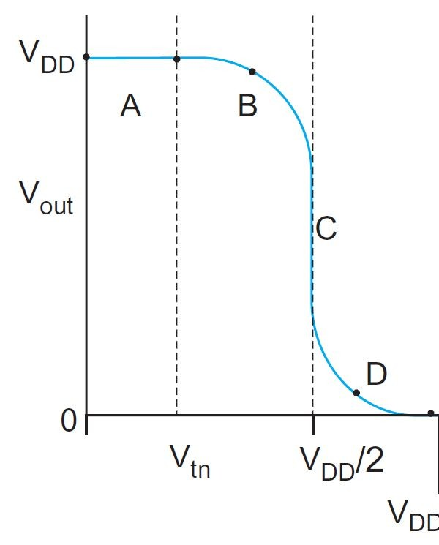
CMOS Inverter DC response
Region D

Slide 10
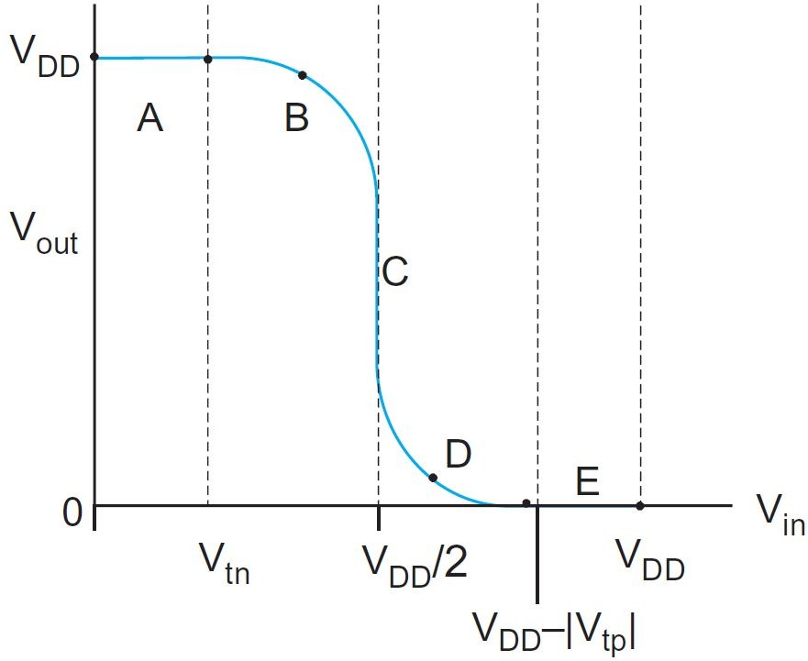
CMOS Inverter DC response
Region E

Slide 11
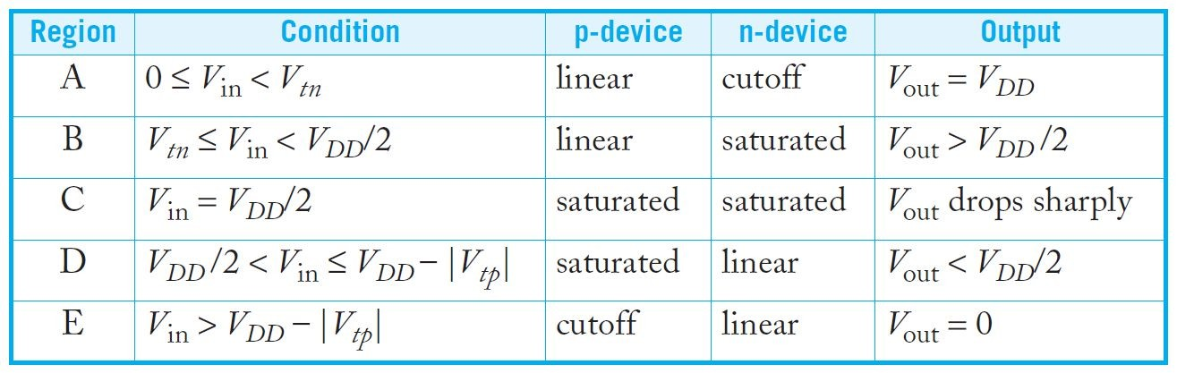
CMOS Inverter DC response
Complete V_{out} vs V_{in}

Slide 12
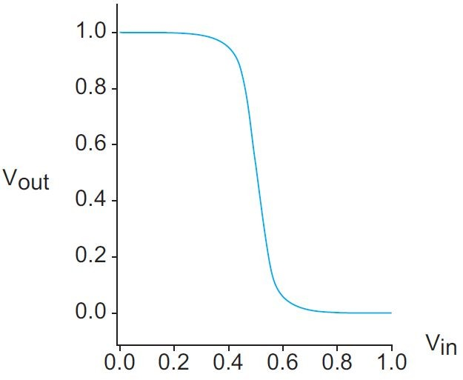
Practical CMOS Inverter DC response
In reality, the sharp change at region C is not that sharp and has finite slope
Theoretical inverter DC response vs Practical inverter DC response
Infinite slope at region C
Finite slope at region C

Slide 13
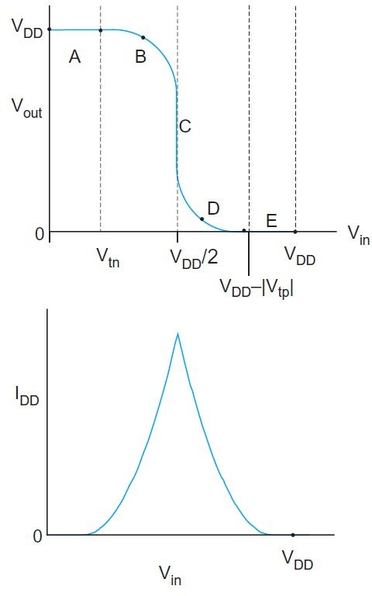
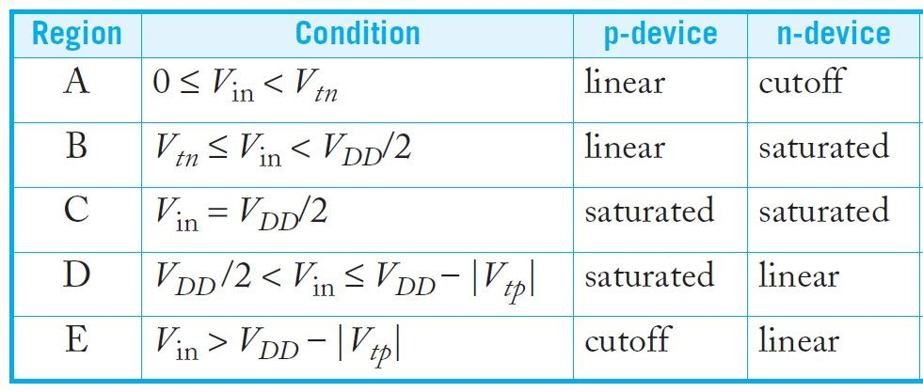
Supply Current
If I_{DD} = I_{dsn} = |I_{dsp}| is the supply current drawn from V_{DD}
I_{DD} is non-zero in regions B, C & D
I_{DD} is zero in regions A & E

Slide 14
Power Consumption
If I_{DD} = I_{dsn} = |I_{dsp}| is the current drawn from supply V_{DD}
I_{DD} is non-zero in regions B, C & D
I_{DD} is zero in regions A & E
That is why we always try to work with strong signals
A strong 0 falls in the region A where I_{DD} ≈ 0
A strong 1 falls in the region E where I_{DD} ≈ 0
I_{DD} ≈ 0 or low implies low power consumption!

Slide 15
Power Consumption
If I_{DD} = I_{dsn} = |I_{dsp}| is the current drawn from supply V_{DD}
I_{DD} is non-zero in regions B, C & D
I_{DD} is zero in regions A & E
That is also why we try to avoid degraded signals
A degraded 0 falls in the region B/C where I_{DD} ≠ 0
A degraded 1 falls in the region D/C where I_{DD} ≠ 0
I_{DD} ≠ 0 or high implies high power consumption!

Slide 16
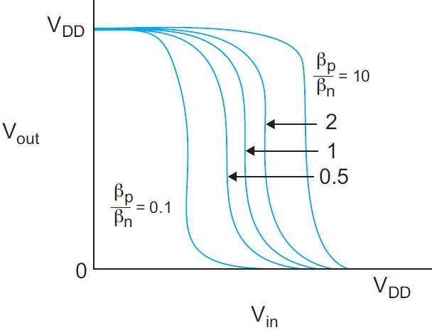
Beta Ratio Effects
The crossover point, where V_{in} = V_{out} is called the input threshold, V_{inv}
For β_{p} = β_{n}, the inverter threshold voltage, V_{inv} = V_{DD}/2 β_{p} / β_{n} is called the beta ratio; r = β_{p} / β_{n}
r = 1 ⇒ inverter is un-skewed
r > 1 ⇒ inverter is HI-skewed
r < 1 ⇒ inverter is LO-skewed
Thus, by changing r we can shift the response!

Slide 17
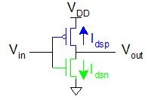
Beta Ratio Effects for a Static CMOS Inverter
We would like to know how V_{inv} changes for a CMOS inverter as we change r
For the CMOS inverter shown:
(-) (-)
^{V}gsp ^{= V}in ^{- V}DD
^{V}dsp ^{= V}out ^{- V}DD
V_{gsn} = V_{in} - 0 = V_{in}
^{V}dsn ^{= V}out ^{- 0 = V}out
V
^{V}dsp
(+)
gsp
(+)
(+)
(+)
^{V}gsn
V
Assume: V = -V
(-)
(-)
dsn
tp tn

Slide 18
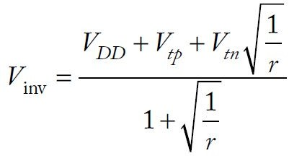
Beta Ratio Effects for a Static CMOS Inverter
For βp ≠ βn, we can calculate the inverter threshold voltage by setting V_{in} = V_{inv}
In region C, both pMOS & nMOS are saturated
So the nMOS and pMOS currents are:
(-)
(-)
^{V}gsp (+)
^{V}dsp
(+)
I = β (V - V )²/2 = β (V - V - V )²/2
I
dsp p gsp
tp p inv
2
DD tp
= β (V
- V ) /2 = β (V
- V )²/2
dsn n gsn tn n inv
tn
Set the currents I_{dsp} = -I_{dsn}
Solve for V_{inv}:
(+)
(+)
^{V}gsn
V
(-)
(-)
dsn

Slide 19
Beta Ratio Effects
So thus for β_{p} ≠ β_{n}, we can calculate the inverter threshold voltage as a function of “r”, where r = β_{p} / β_{n}

Slide 20
Other CMOS Gates
DC transfer characteristics of other static CMOS gates can be understood by collapsing the gates into an equivalent inverter
Series transistors can be viewed as a single transistor of greater length
If only one of several parallel transistors is ON, the other transistors can be ignored
If several parallel transistors are ON, the collection can be viewed as a single transistor of greater width

Slide 21
Noise Margin (Noise Immunity)
Noise margin is closely related to the DC voltage characteristics
Helps determine the allowable noise voltage on the input of a gate so that the output will not be corrupted
The specification most commonly used to describe noise margin uses two parameters:
The LOW noise margin, NM_{L}
The HIGH noise margin, NM_{H}

Slide 22
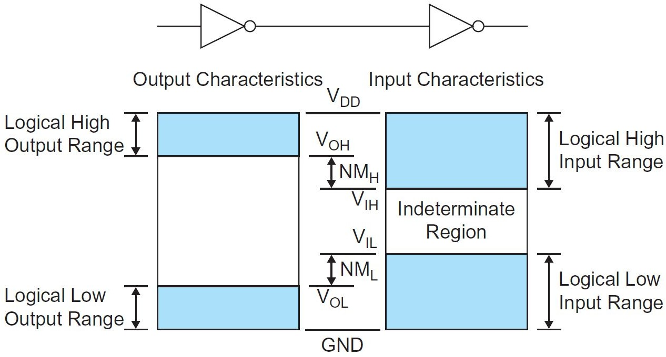
Noise Margin
Voltage definitions:
V_{IH} = minimum HIGH input voltage V_{IL} = maximum LOW input voltage V_{OH}= minimum HIGH output voltage V_{OL} = maximum LOW output voltage NM_{L} = The LOW noise margin
NM_{H} = The HIGH noise margin
Driver gate
Receiver gate

Slide 23
Low Noise Margin
The LOW noise margin (NM_{L}) is the difference in maximum LOW input voltage recognized by the receiving gate and the maximum LOW output voltage produced by the driving gate
Driver gate
Receiver gate
NM_{L} = V_{IL} - V_{OL}

Slide 24
High Noise Margin
The HIGH noise margin (NM_{H}) is the difference between the minimum HIGH output voltage of the driving gate and the minimum HIGH input voltage recognized by the receiving gate
Driver gate
Receiver gate
NM_{H} = V_{OH} - V_{IH}

Slide 25

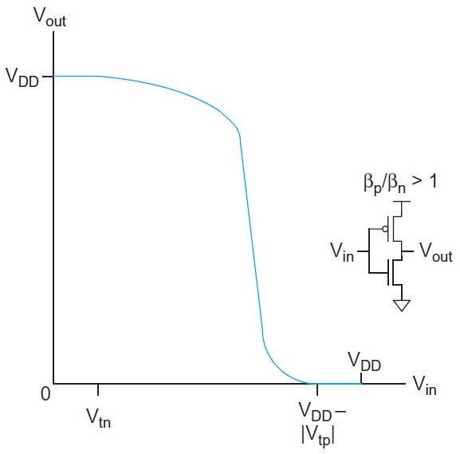
Selecting V_{IL}, V_{IH}, V_{OL} & V_{OH}
How to choose the logic levels V_{IL}, V_{IH} , V_{OL} & V_{OH} such that the noise margins NM_{L} & NM_{H} are maximized?
Use the DC transfer characteristics!
Driver gate
Receiver gate

Slide 26
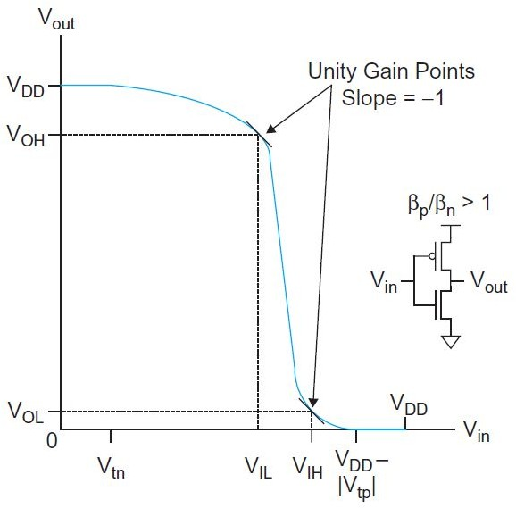
Selecting V_{IL}, V_{IH}, V_{OL} & V_{OH}
How to choose the logic levels V_{IL}, V_{IH} , V_{OL} & V_{OH} such that the noise margins NM_{L} & NM_{H} are maximized?
Driver gate
Receiver gate
Use the DC transfer characteristics!
Logic levels are defined at the unity gain point where the slope is –1
This gives a conservative bound on the worst case static noise margin

Slide 27
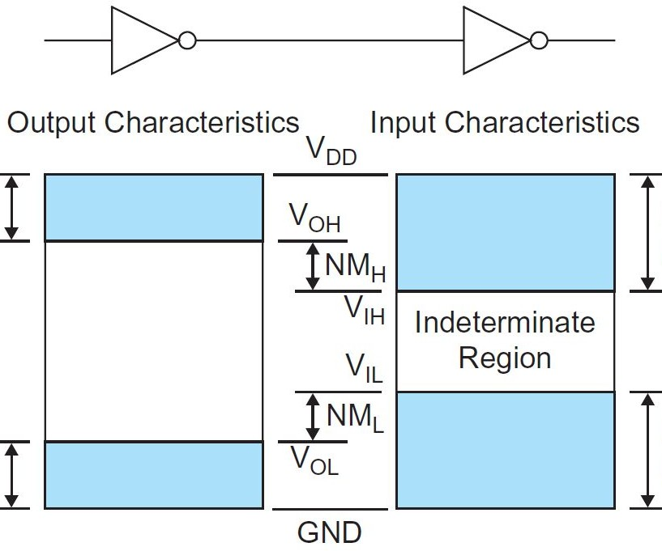
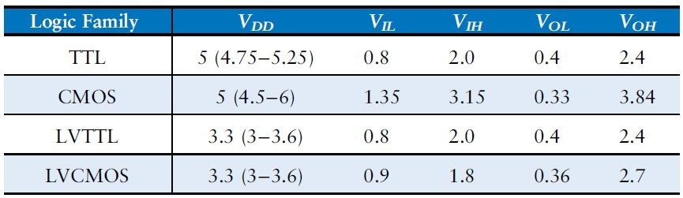
Selecting V_{IL}, V_{IH}, V_{OL} & V_{OH}
Logic levels of typical 5 V and 3.3 V logic families
Driver gate
Receiver gate

Slide 28
Noise Margin: Summary
NM_{L} or NM_{H} too small: the gate may be disturbed by noise that occurs on the inputs
An unskewed gate has equal noise margins: which maximizes immunity to arbitrary noise sources
If a gate sees more noise in the high or low input state: the gate can be skewed to improve that noise margin at the expense of the other
Driver gate
Receiver gate

Slide 29
Noise Margin: Summary
Noise sources tend to scale with the supply voltage: so noise margins are best given as a fraction of the supply voltage; for example 0.3V_{DD}
A noise margin of 0.4 V is quite comfortable in a 1.8 V process, but marginal in a 5 V process
Driver gate
Receiver gate

Slide 30
Pass Transistor DC Characteristics
Recall from our previous lectures that
nMOS transistors pass ‘0’s well but ‘1’s poorly
pMOS transistors pass ‘1’s well but ‘0’s poorly
We are now better prepared to define how “poorly”

Slide 31
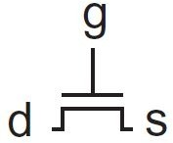
nMOS Pass Transistor DC Characteristics
To keep an nMOS transistor ON, we need
V_{gs} ≥ V_{tn}
⇒ V_{g} - V_{s} ≥ V_{tn}
⇒ V_{s} ≤ V_{g} - V_{tn}
^{⇒ V}s(max) ^{= V}g ^{- V}tn

Slide 32
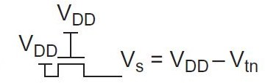
nMOS Pass Transistor DC Characteristics
To keep an nMOS transistor ON, we need
●
^{V}s(max) ^{= V}g ^{- V}tn
nMOS transistors passing ‘1’ (V_{in} = V_{DD}; V_{out} = ?)
Gate is connected to V_{DD}: V_{g} = V_{DD}
Current flowing from drain to source
V_{in}= V_{d} = V_{DD}; V_{out} = V_{s} = ?
But we know V_{s(max)} = V_{g} - V_{tn} ⇒ V_{out(max)} = V_{DD} - V_{tn}
nMOS transistors attempting to pass a ‘1’ never pass above V_{DD} - V_{tn}

Slide 33
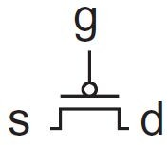
pMOS Pass Transistor DC Characteristics
To keep a pMOS transistor ON, we need
V_{sg} ≥ |V_{tp}|
⇒ V_{s} - V_{g} ≥ |V_{tp}|
⇒ V_{s} ≥ V_{g} + |V_{tp}|
⇒ V_{s(min)} = V_{g} + |V_{tp}|

Slide 34
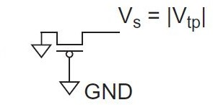
pMOS Pass Transistor DC Characteristics
To keep a pMOS transistor ON, we need
●
^{V}s(min) ^{= V}g ^{+ |V}tp|
pMOS transistors passing ‘0’ (V_{in} = 0; V_{out} = ?)
Gate is connected to GND: V_{g} = 0
Current flowing from source to drain
V_{in}= V_{d} = 0; V_{out} = V_{s} = ?
But we know V_{s(min)} = V_{g} + |V_{tp}| ⇒ V_{out(min)} = |V_{tp}|
pMOS transistors attempting to pass a ‘0’ never pass lower than |V_{tp}|

Slide 35
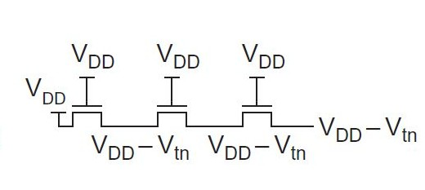
nMOS Pass Transistor DC Characteristics
Series nMOS transistors passing ‘1’ (V_{DD})
T1 T2
T3
If all of the transistors have gates tied to V_{DD}
●
●
^{V}g(T1) ^{= V}g(T2) ^{= V}g(T3)
= V_{DD}
^{V}in(T1) ^{= V}DD^{; V}out(T3) ^{= ?}
Output of Transistor T1: V_{out(max), T1} = V_{g(T1)} - V_{tn(T1)} = V_{DD} - V_{tn}
Output of Transistor T2: V_{out(max), T2} = V_{g(T2)} - V_{tn(T2)} = V_{DD} - V_{tn}
Output of Transistor T3: V_{out(max), T3} = V_{g(T3)} - V_{tn(T3)} = V_{DD} - V_{tn}

Slide 36
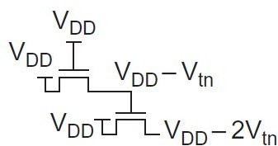
nMOS Pass Transistor DC Characteristics
nMOS transistor driven by degraded output
If T1 transistor has gate tied to V_{DD}
^{V}g(T1) ^{= V}DD^{; V}in ^{= V}DD^{; V}out ^{= ?}
T1
Output of Transistor T1: V_{out(max), T1} = V_{g(T1)} - V_{tn(T1)} = V_{DD} - V_{tn}
T2
Output of transistor T1 is now driving the gate of transistor T2
T2 transistor has gate tied to V_{DD} - V_{tn}
^{V}g(T2) ^{= V}DD ^{- V}tn^{; V}in ^{= V}DD^{; V}out ^{= ?}
Output of Transistor T2: V_{out(max), T2} = V_{g(T2)} - V_{tn(T2)} = (V_{DD} - V_{tn}) - V_{tn} = V_{DD} - 2V_{tn}

Slide 37
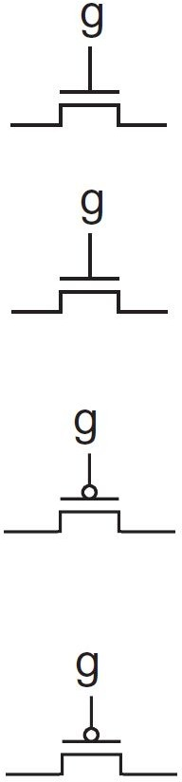
Pass Transistor DC Characteristics: Summary
nMOS pass transistor
V_{in} = 0
V_{out} = 0
V_{in} = GND ⇒ V_{out} = GND (strong 0)
V_{in} = V_{DD}
⇒ V_{out(max)} = V_{g} - V_{tn} (degraded 1)
^{V}in ^{= V}DD
^{V}out ^{= V}g ^{- V}tn
pMOS pass transistor
V_{in} = 0
V_{out} = |V_{tp}|
V_{in} = GND
V_{in} = V_{DD}
⇒ V_{out(min)} = |V_{tp}| (degraded 0)
⇒ V_{out} = V_{DD} (strong 1)
^{V}in ^{= V}DD
^{V}out ^{= V}DD

Slide 38
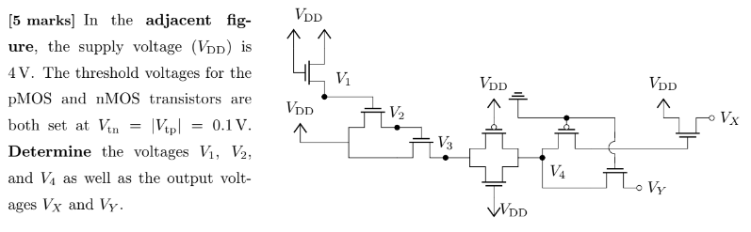

Slide 39
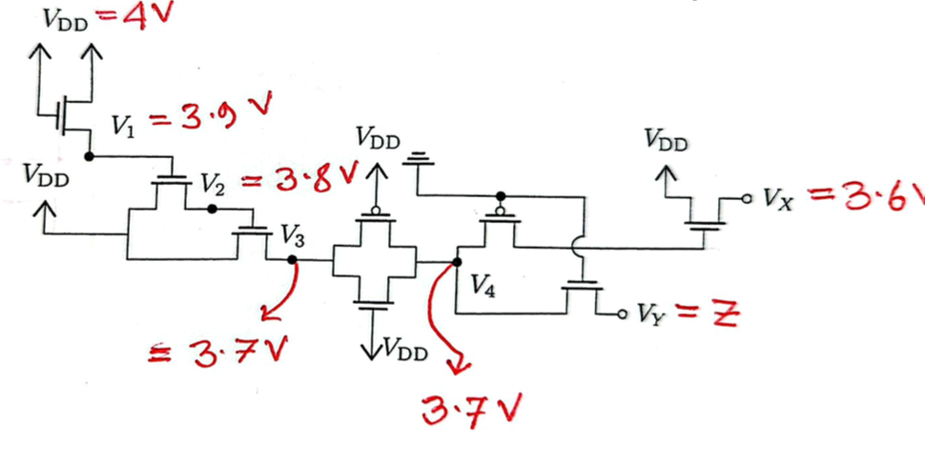

Slide 40
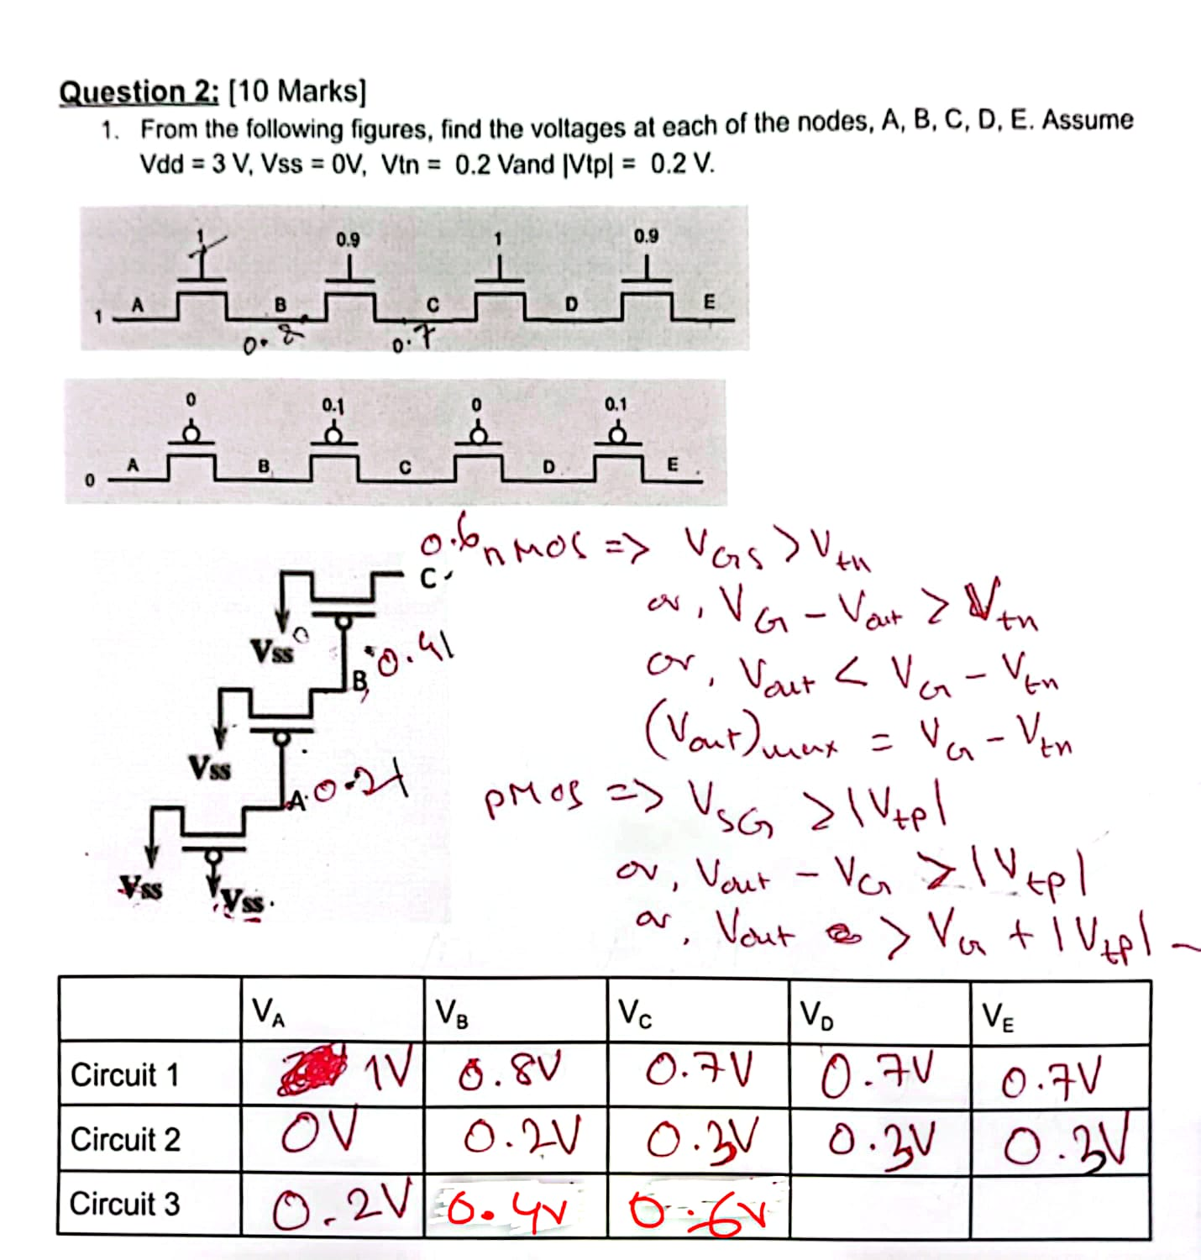

Slide 41
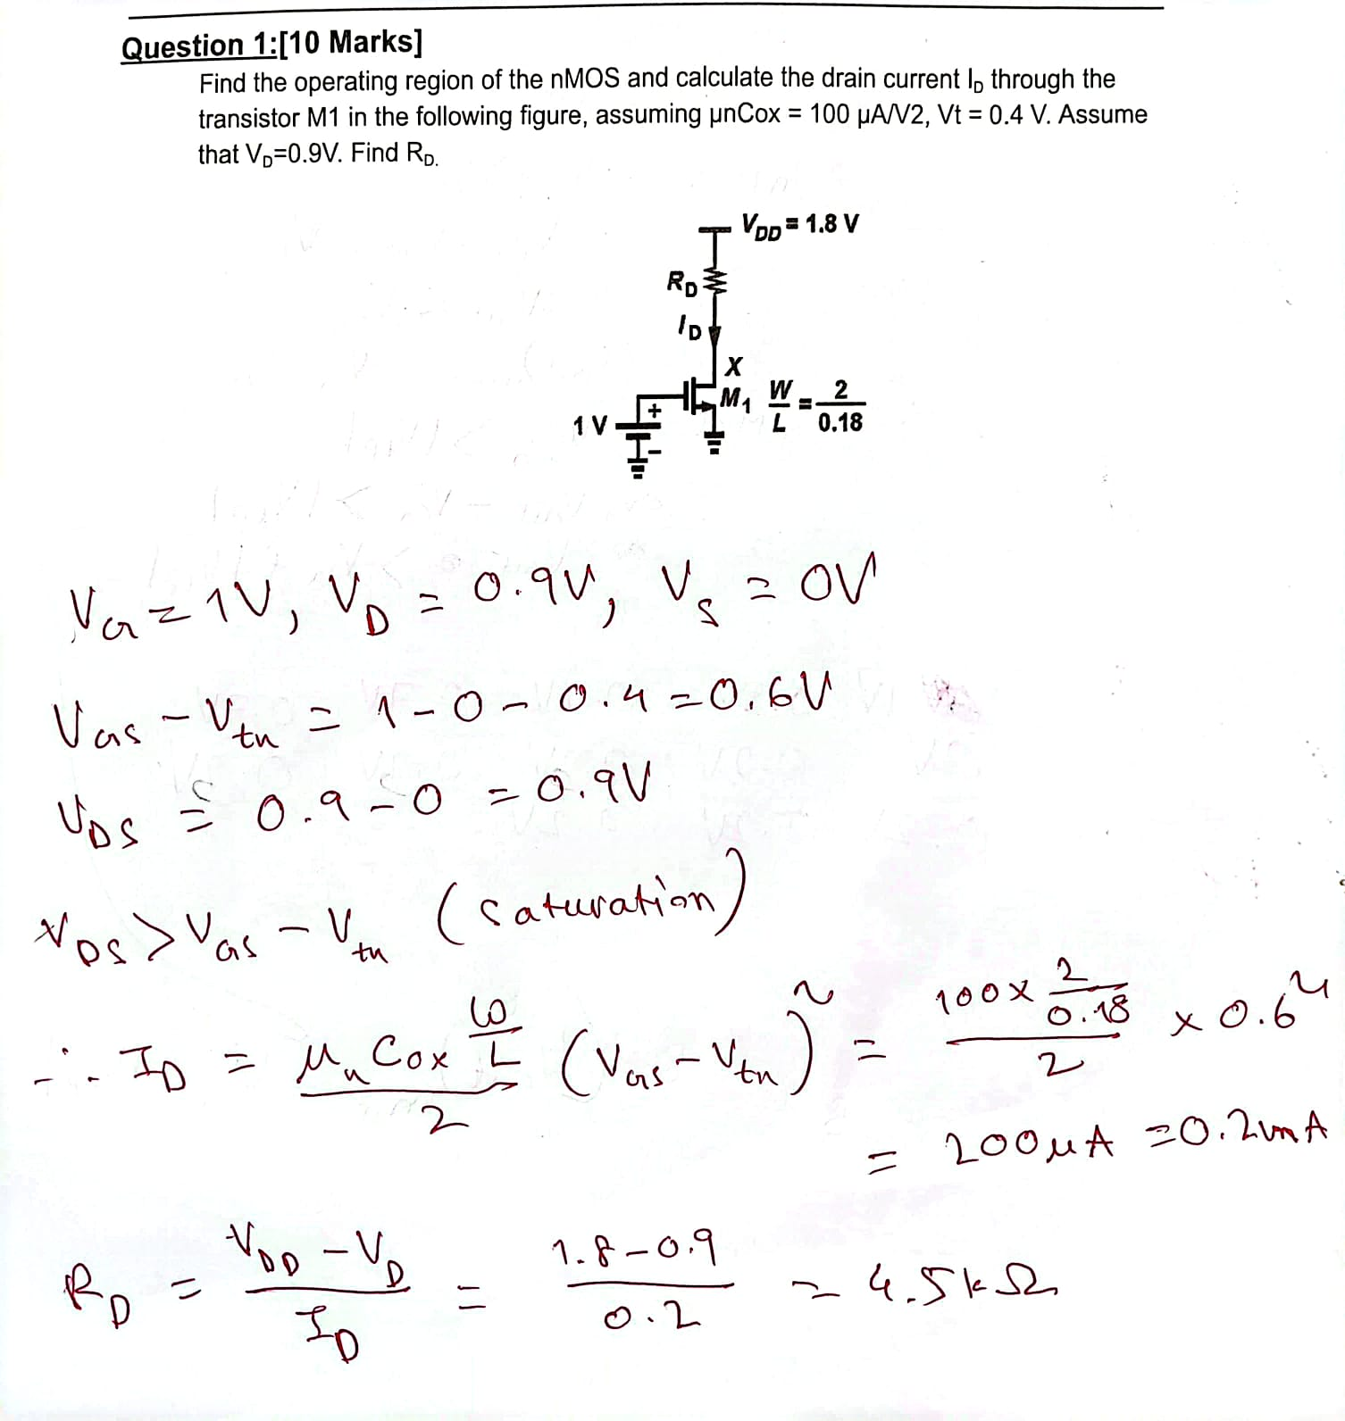

Slide 42
Pass Transistor DC Characteristics: Summary
nMOS/pMOS pass transistors sometimes produce degraded outputs
The loss is sometimes called a threshold drop
In old processes where V_{DD} was high and Vt was a small fraction of V_{DD}, the threshold drop was tolerable
In modern processes V_{DD} is significantly lower and Vt is almost ⅓ of V_{DD}, the threshold drop can produce an invalid or marginal logic at the output
To solve this problem we use CMOS transmission gates

Slide 43
Thank You!

